Slide 1
ROS – Record play & roswtf

Slide 2
init
roscore
rosrun turtlesim turtlesim_node
rosrun turtlesim turtle_teleop_key

Slide 3
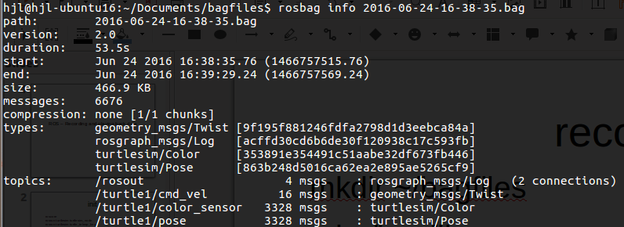
record
mkdir ~/bagfiles
cd ~/bagfiles
rosbag record -a
rosbag info <your bagfile>

Slide 4
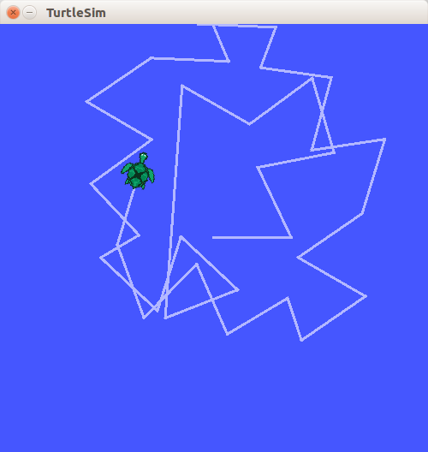
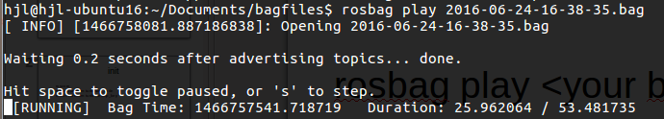
play
rosbag play <your bagfile>
rosbag play -r 4 <your bagfile>
More faster!!

Slide 5
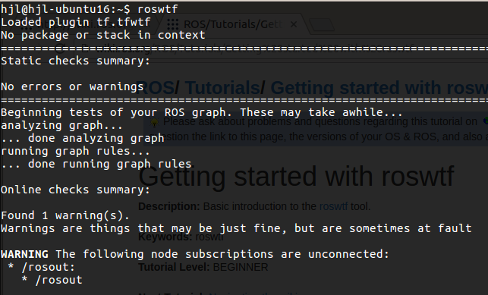
roswtf
$ roswtf

